Slide 1
Co-NavGPT: Multi-Robot Cooperative Visual Semantic Navigation Using Vision Language Models
Authors: Bangguo Yu, Qihao Yuan, Kailai Li, Hamidreza Kasaei, and Ming Cao
Presenting by: Gopireddy Avinash Reddy

Slide 2
Introduction
Robots must search for objects in large, unknown environments.
Existing approaches mostly use single robots, leading to:
slow exploration
low efficiency in complex spaces
poor fault tolerance.
Vision-Language Models (VLMs) introduced for navigation provide semantic reasoning, but are still used in single-agent systems.
Specific Problem: How to enable multiple robots to collaboratively locate a target object using shared scene understanding and common-sense reasoning?
Notes:
Visual semantic navigation is crucial for robots operating in homes, offices, or disaster sites. Robots need to find items like a phone, a chair, or a bed inside an unknown space. Traditional approaches rely on either classical mapping or learning-based methods, but almost all work with one robot at a time. This creates inefficiencies—especially in large environments—since a single robot must explore everything alone and has poor fault tolerance as a single incorrect decision or unexpected obstacle can significantly delay or derail the navigation process. Recently, Vision-Language Models like GPT-4o have been used as semantic planners, but again only for single agents. The paper addresses the specific problem: enabling multi-robot teams to collaboratively explore, reason about the environment, and find objects faster by using a VLM as the global planner.”

Slide 3
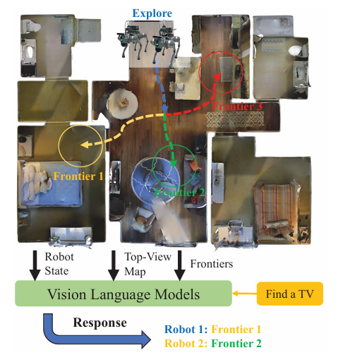
Notes:
This figure shows Two robots visual target navigation example. When multiple unexplored frontiers are detected, the vision language model assigns the frontier for each robot based on the current observation and the target object.

Slide 4
Proposed Novel approach
Introduces Co-NavGPT, the first multi-robot visual navigation system using a VLM as a global planner.
Key innovations:
Merge local maps into a global 3D semantic map.
Extract frontier regions and encode them into visual + textual prompts.
GPT-4o assigns optimal frontiers to each robot → coordinated exploration.
No task-specific training required (zero-shot planning).
Notes:
The paper’s main contribution is Co-NavGPT—a novel multi-robot framework where a Vision-Language Model acts as the global planner.

Slide 5
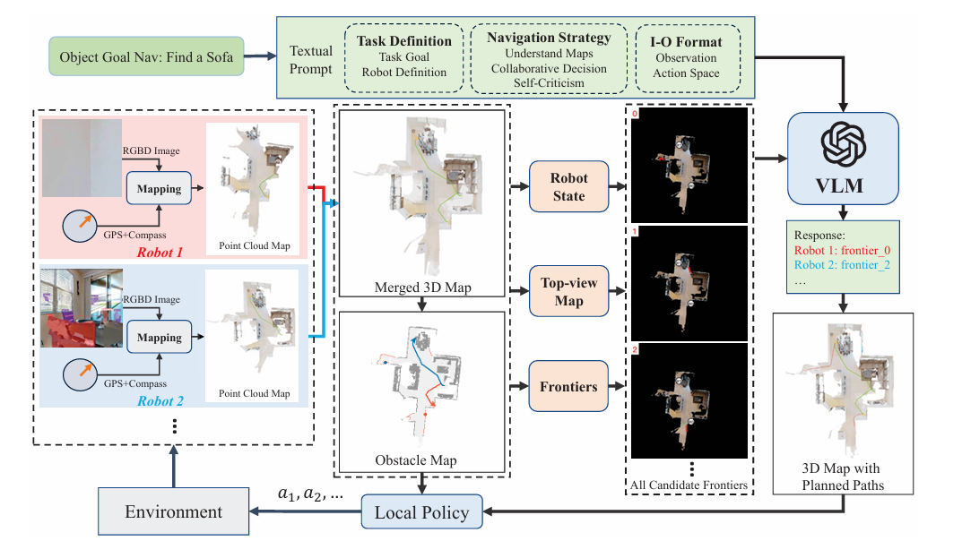
Notes:
This figure shows the System architecture of the proposed multi-robot navigation framework.
Each robot builds a local 3D map from RGB-D images. These are merged into a global point-cloud map. From this map, the system extracts frontier regions, which represent unexplored areas. These frontiers, plus robot positions and the merged map, are turned into visual prompts and a structured text prompt and passed to a vision-language model, which acts as a global planner to assign frontier goals to each robot. GPT-4o then assigns which frontier each robot should explore. A local policy then computes paths to the assigned frontiers based on the obstacle map, enabling coordinated exploration and target search. No task-specific training required as Robots can leverage VLM’s commonsense knowledge (for example beds are in bedrooms) to plan exploration routes toward likely locations of target objects, even in new, unseen environments.

Slide 6
Connection to Motion Planning
VLM performs high-level planning: frontier selection, reasoning about scene semantics, multi-agent coordination.
Local planner uses navigation algorithms for safe motion.
Remaining Issues:
Limited by object detection accuracy.
Multi-floor navigation still challenging.
VLM may fail with ambiguous frontier prompts.
Notes:
So the VLM is essentially performing high-level planning—coordinating robots, reasoning about spatial layout, and making semantically informed decisions. The local planner still handles the low-level path execution. Some limitations remain: incorrect object detection can cause failures, multi-floor scenarios are hard, and VLM reasoning is only as good as the prompt quality.”

Slide 7
Results and Discussion
A. Simulation Experiment:
All experiments are conducted using the Habitat simulator.
Each robot receives 480×640 RGB D observations, odometry information, and a goal category encoded as an integer.
Evaluation Metrics: Success Rate (SR), Success weighted by the Path Length (SPL), and Distance to Goal (DTG) for multi-robot tasks.
Baselines: Greedy, Cost-Utility, Random Sampling and Multi-SemExp
Notes:
“In simulation, the authors use the Habitat simulator to evaluate multi-robot navigation. Each robot receives RGB-D images, odometry, and the target category as input. Performance is measured using three standard metrics: Success Rate, SPL for path efficiency, and Distance to Goal at episode end. They compare Co-NavGPT against several baselines—Greedy, Cost-Utility, Random Sampling, and Multi-SemExp—to test both classical and learning-based exploration strategies.”

Slide 8
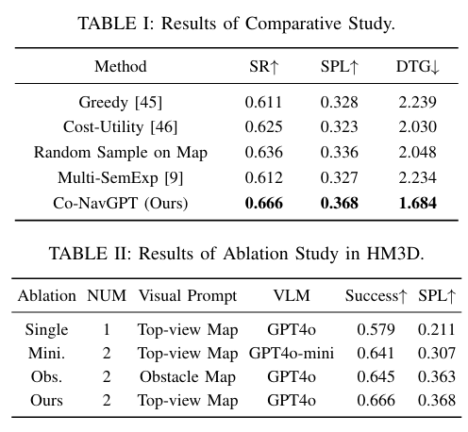
Notes:
Co NavGPT, consistently outperforms all baselines across all three metrics (SR, SPL, and DTG). Among traditional baselines, the Cost-Utility method outperforms the Greedy strategy, demonstrating the benefit of jointly considering utility based on frontier size and distance from the robot to the frontier as cost during goal assignment. The results of ablation study, shown in Table II, demonstrate that Co NavGPT achieves the best performance in both success rate and SPL. Replacing the top-view map with the obstacle map (Obs.) leads to a drop in success rate, indicating the importance of semantic context (e.g., color and layout) in the VLM-based decision making. Substituting GPT-4o with GPT-4o-mini (Mini.) reduces performance across both metrics, suggesting that the reasoning capability of larger VLMs contributes significantly to task effectiveness. Finally, the single-robot configuration (Single) yields the lowest per formance, highlighting the robustness and scalability benefits of the multi-robot framework

Slide 9
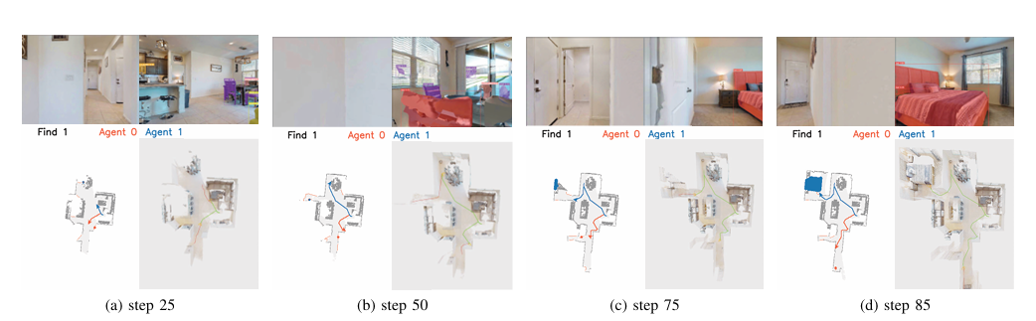
Notes:
Visualization of the visual target navigation process in the Habitat simulator using two robots to locate a bed. The top row shows first-person RGB observations from both robots (Agent 0 in red, Agent 1 in blue) at different time steps. The bottom row presents the corresponding 2D exploration map and 3D point cloud map. The red and blue lines represent the respective paths of Agent 0 and Agent 1. Red and blue dots denote frontier goals assigned by the vision-language model.

Slide 10
Results and Discussion
B. Real-World Experiment:
Two Unitree Go2 quadruped robots, each equipped with a RealSense D455 RGB-D camera and a Livox Mid-360 LiDAR.
Deployed in a real-world, previously unseen lab environment.
Navigation tasks include locating objects: a chair, a sink, and a person.
Result: VLM successfully assigns complementary frontiers to the robots, enabling cooperative exploration and efficient target search
The entire system runs in real time at approximately 5 FPS.
Notes:
“In the real-world setup, the authors use two Unitree Go2 quadruped robots equipped with a RealSense RGB-D camera and a Livox LiDAR. They deploy the system in an unseen lab environment and test tasks like finding a chair, a sink, and even a person. The VLM consistently assigns complementary frontiers to each robot, allowing them to split up and explore efficiently. The entire pipeline runs in real time at about 5 FPS, demonstrating that their approach is practical for real multi-robot navigation.”

Slide 11
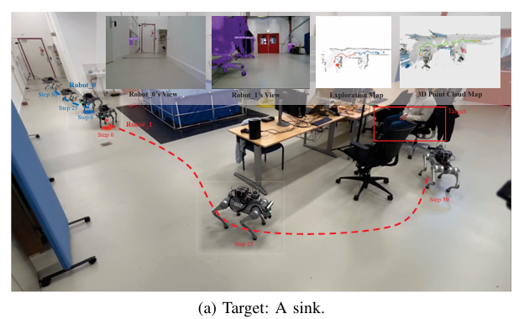
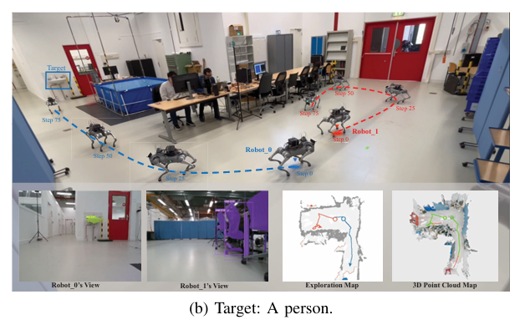
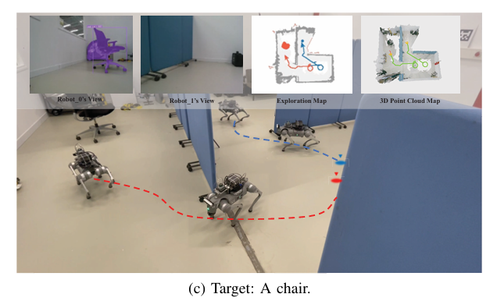
Notes:
Real-world multi-robot visual target navigation. Each scene shows the first-person RGB images, the exploration map, and the 3D point cloud map. In (a), the robots search for a sink; (b) search for a person; (c) search for a chair. Red and blue lines denote the trajectories of the two robots.

Slide 12
Connection to Our Project
We plan to use Co-NavGPT as a baseline for evaluating multi-robot coordination.
Like Co-NavGPT, we will use both simulation environments and two Unitree Go2 robots for real-world deployment.
Our system will integrate camera + LiDAR inputs with text-based task prompts to generate collaborative plans and execute multi-robot tasks.
Co-NavGPT provides a strong reference point for comparing how different VLM-driven planning strategies influence multi-robot efficiency and decision-making.
Notes:
“In our project, we plan to use Co-NavGPT as a baseline to benchmark multi-robot coordination. Like the paper, we’ll run experiments in both simulation and with two Unitree Go2 robots for real-world validation. Our system will fuse camera and LiDAR inputs with text-based task prompts so a VLM can generate motion plans and multi-robot tasks. Using Co-NavGPT as a reference helps us compare how different VLM-driven planning strategies affect coordination efficiency and decision-making.”

